Slide 1
Denoise Microscopic Data With Deep Learning
Group no.2
Syeda Qurat ul Ain Naqvi
Sonali Godavarthy
Zakriya Shakeel

Slide 2
Non-DL Approach Results
We added Gaussian Noise to a image and denoised it using
Box Filter
Gaussian Filter
Median Filter
Box3D Filter
Weiner Filter

Slide 3
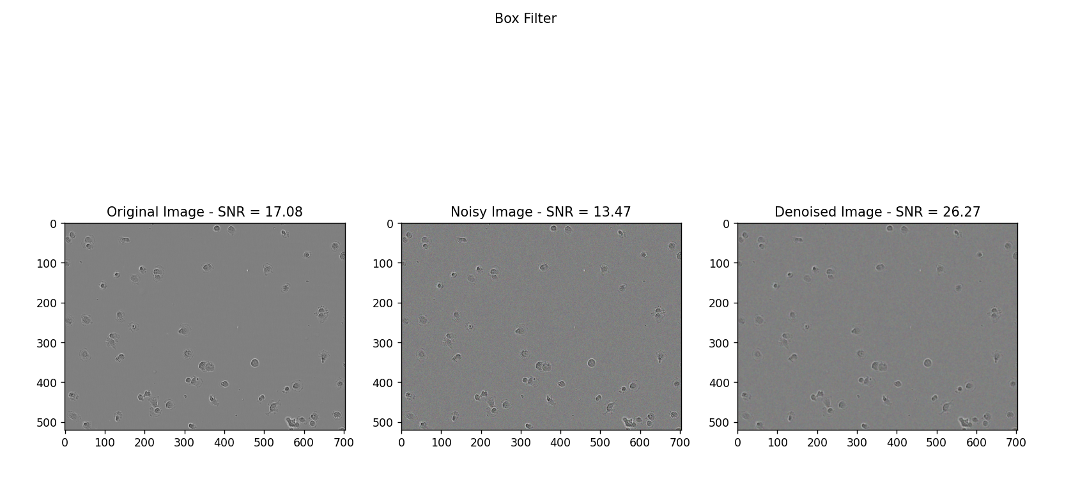

Slide 4
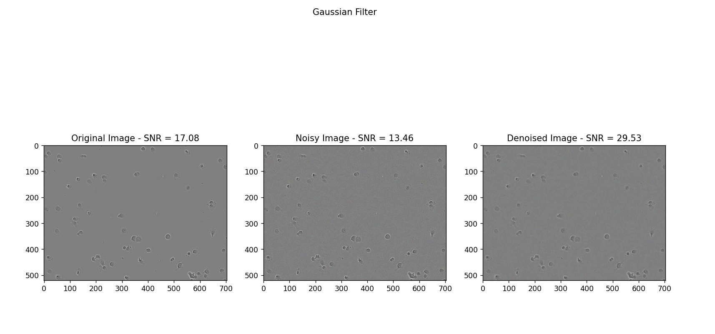

Slide 5
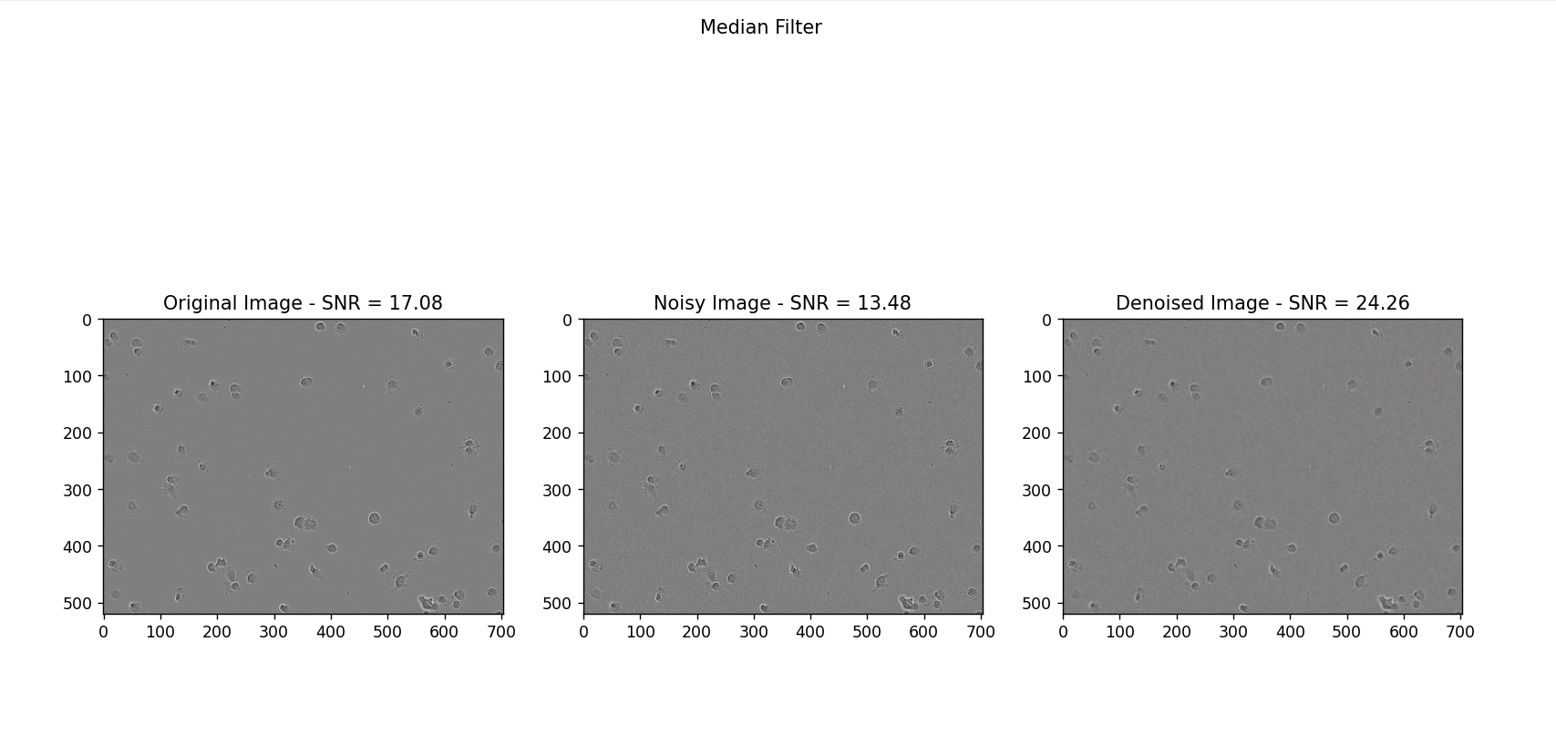

Slide 6
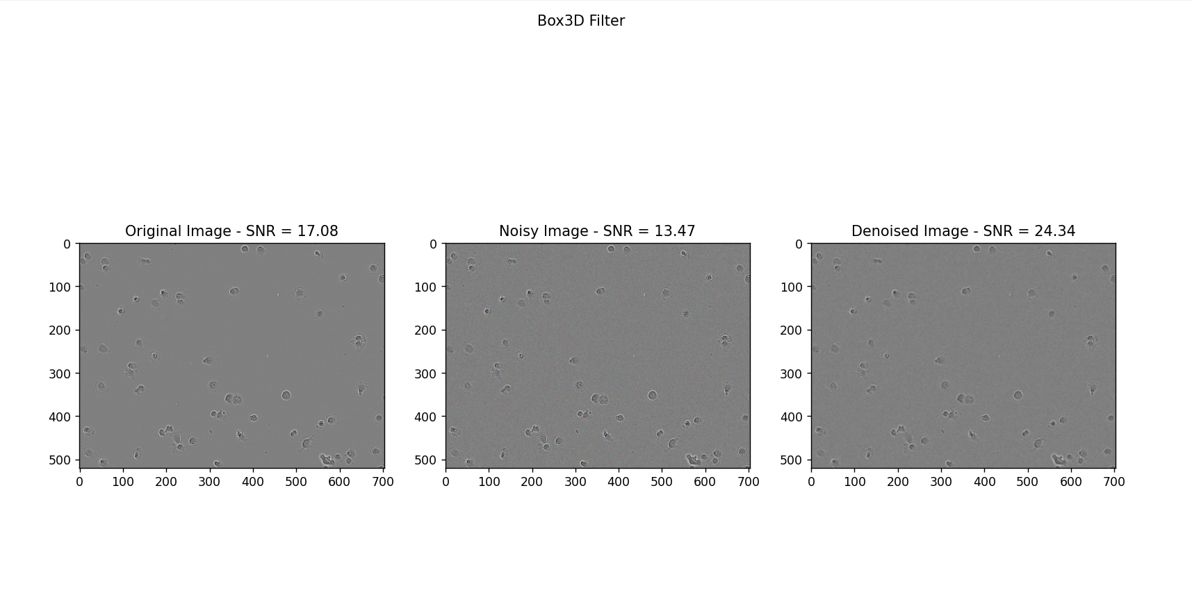

Slide 7
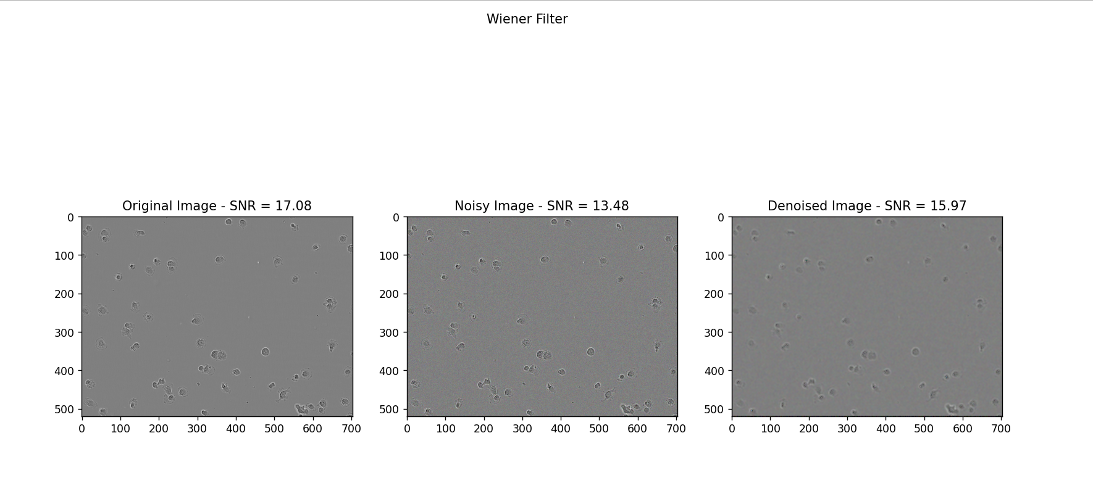

Slide 8
DL Approach Results
We have trained the model using the dataset provided by the writers of the research paper
We have denoised the images using the same model
We applied the model to our own dataset

Slide 9
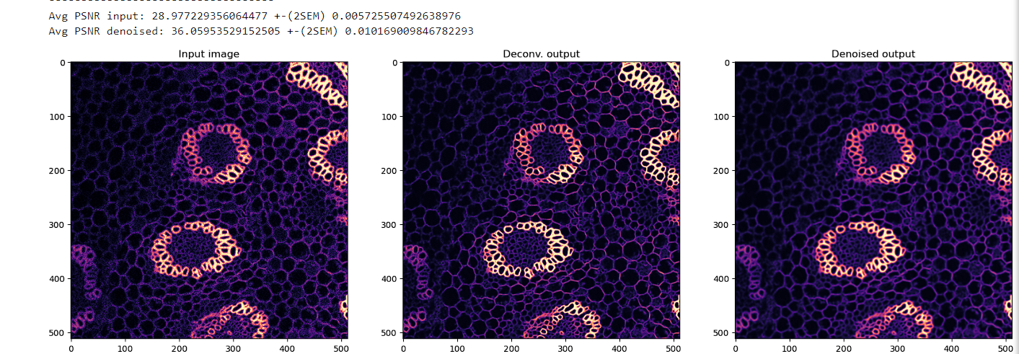
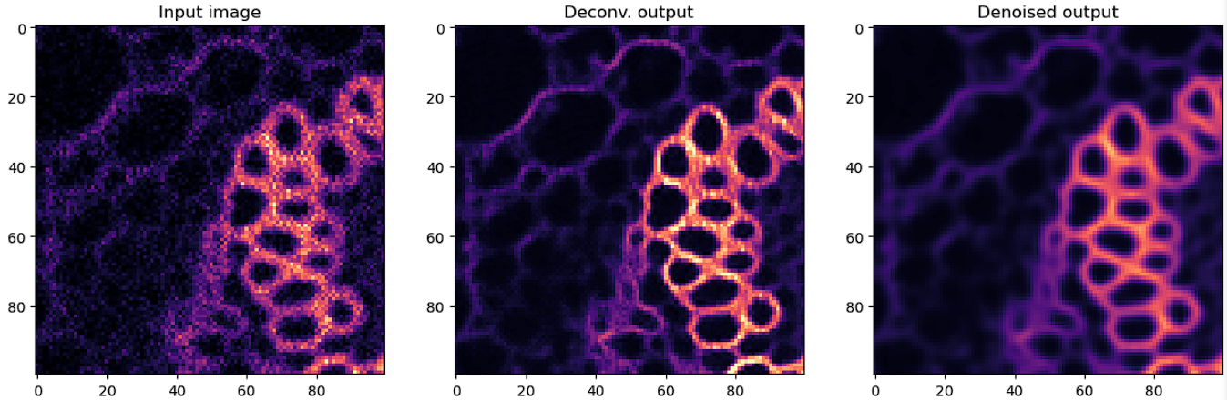
Results of their own Noisy Microscopic Image

Slide 10
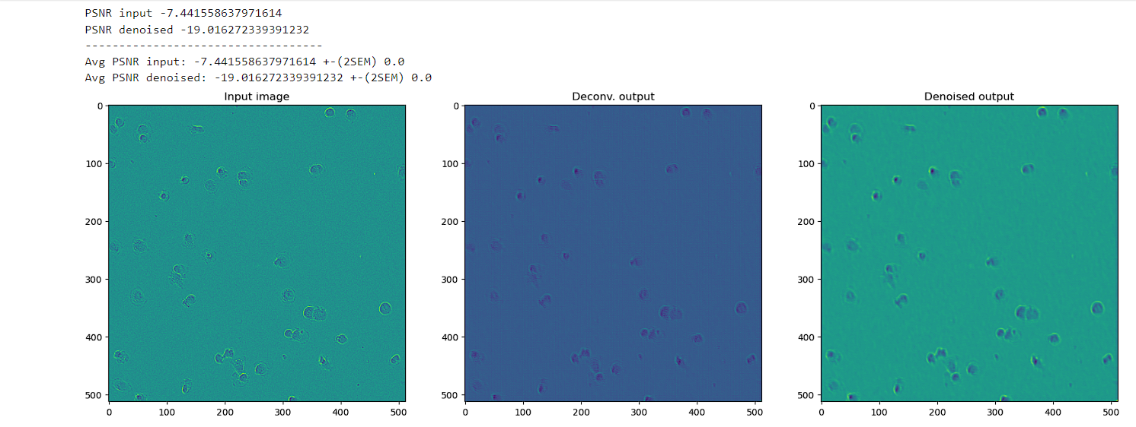
Results of our Noisy Microscopic Image

Slide 11
Conclusion
We achieved good results on Gaussian Filter using Non-DL approach which gives us SNR of 29.53
Applied model to the data provided by researchers and achieved SNR of 36.05

Slide 12
THANK YOU

